Slide 1

Tallinn and Foursquare
Raivo Kartau

Slide 2
This projects tries to show that the Foursquare Api is not something that one should use in programs/apps etc.

Slide 3
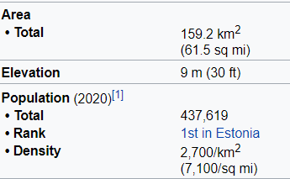
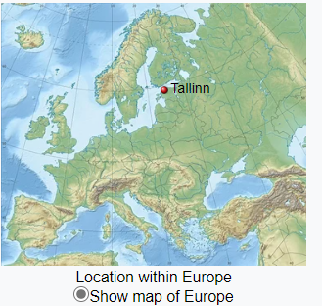
Tallinn:
Tallinn - Wikipedia

Slide 4
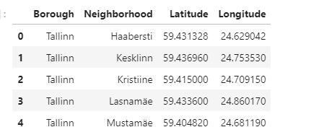
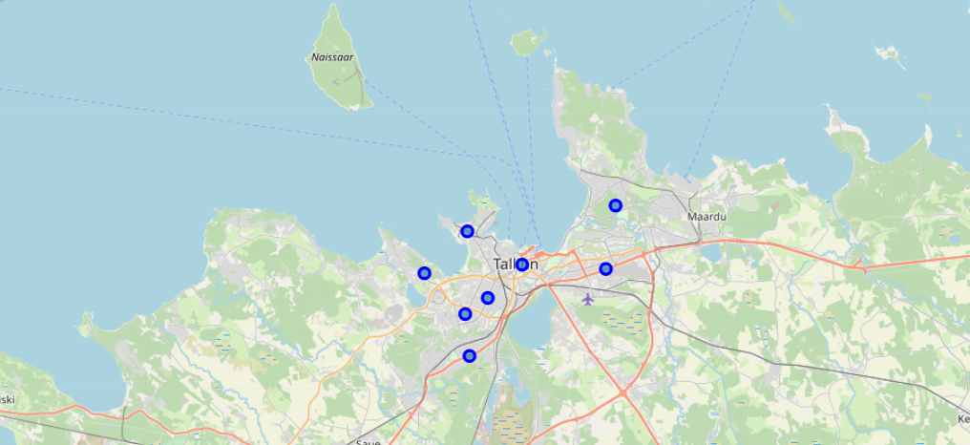
Borough in Tallinn
I remind you this is a city of almost 500 000 people living in it…

Slide 5
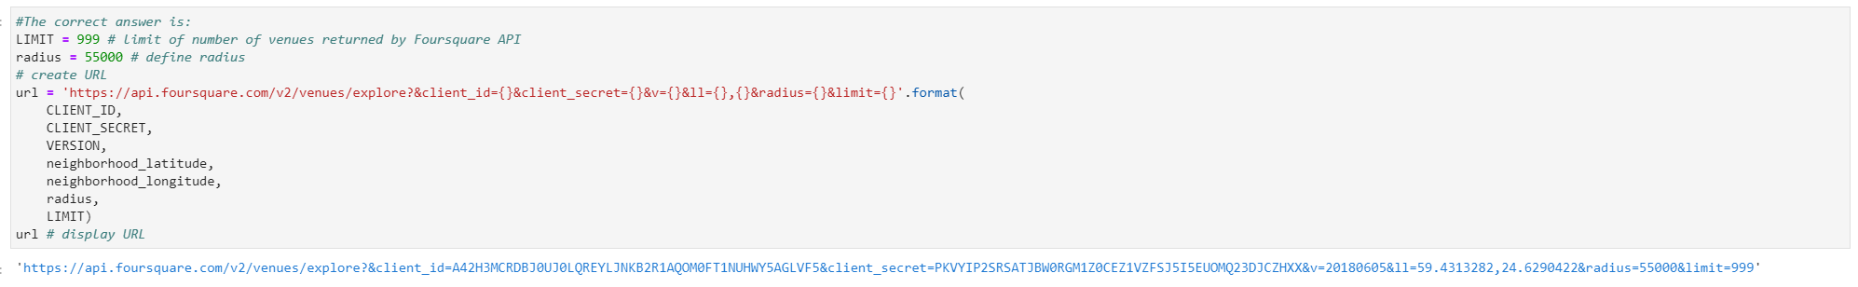
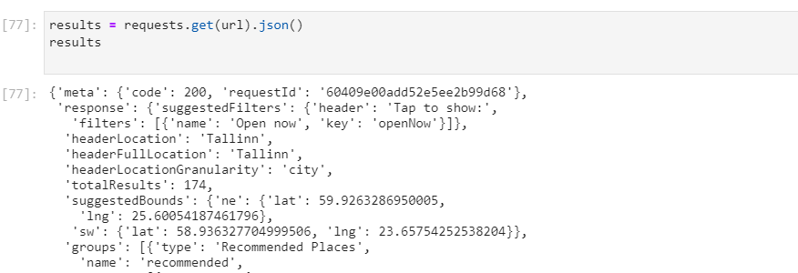
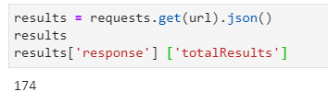
After setting the limit of venues to 999 in Tallinn

Slide 6
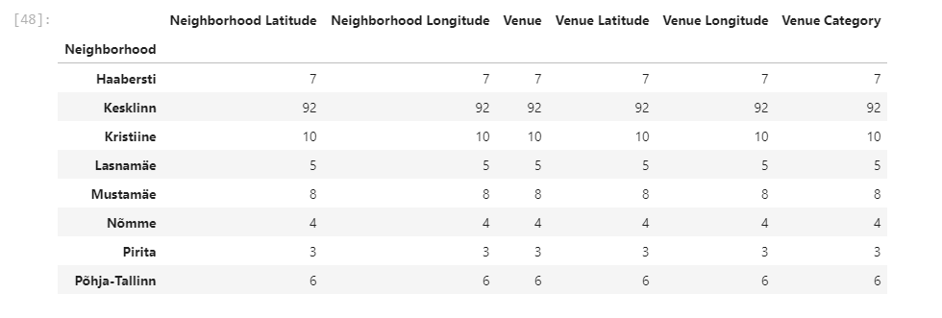
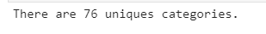
After Consolidating the Venues to Borough it was clear that the data is crooked towards central city= Kesklinn

Slide 7
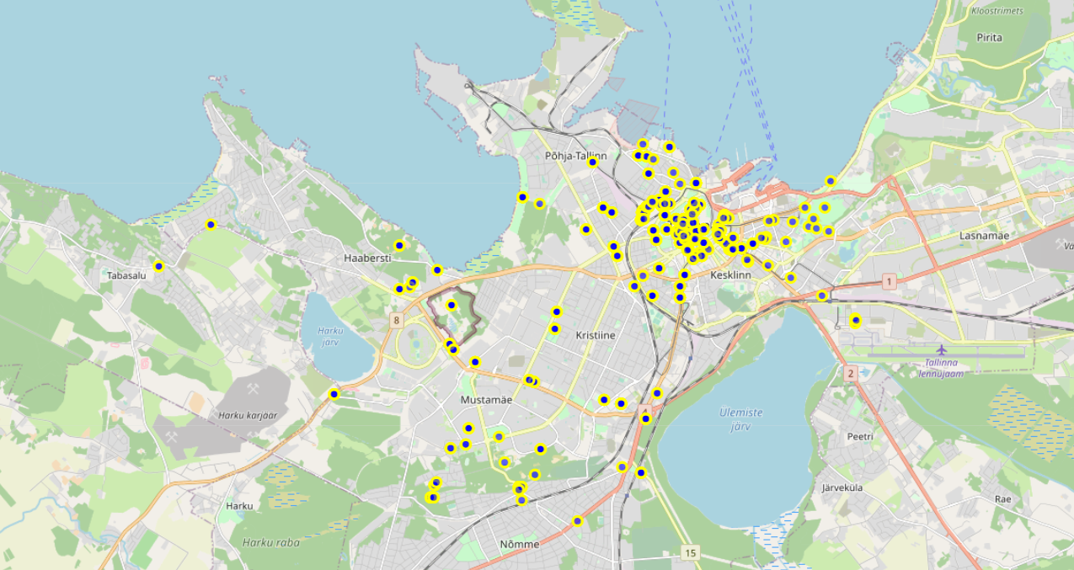
On map it looks like this

Slide 8
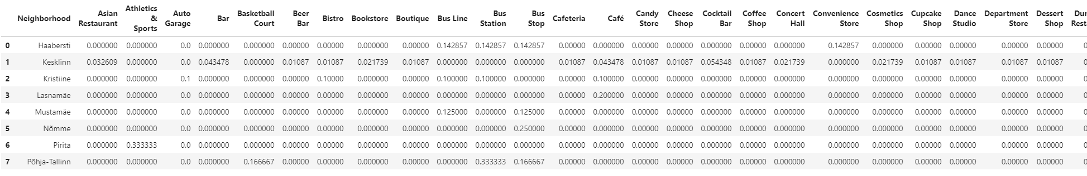
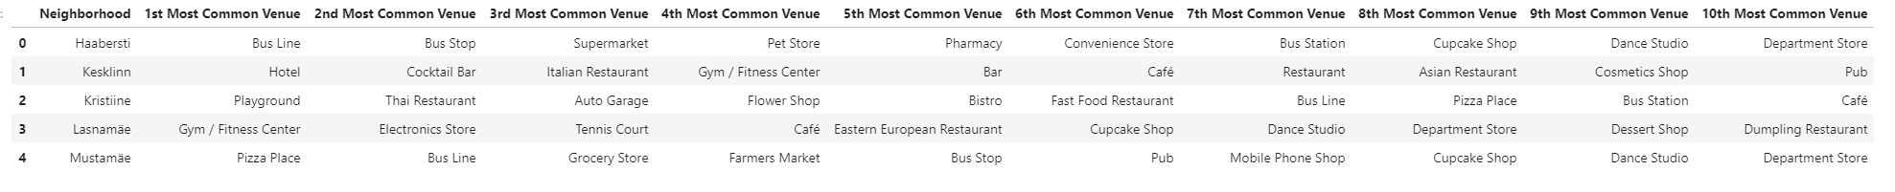
I still analysed the crooked info based on area and the venue categories:
The venue type based on a location
10 most common in similar areas:

Slide 9
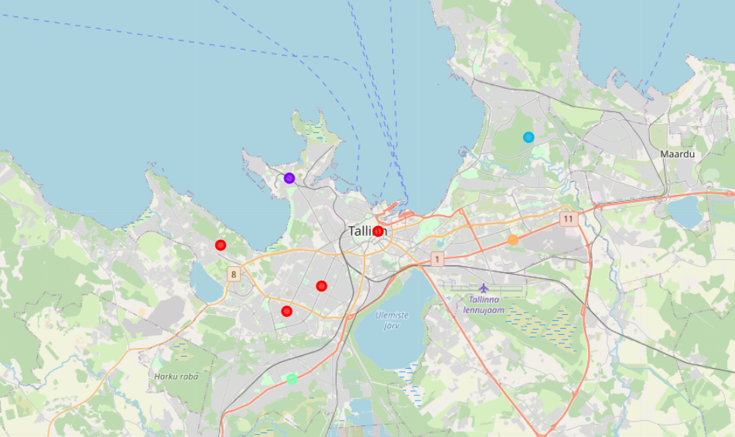
Did the map on most similar areas based on 5 clusters

Slide 10
Clusters and the venues in there:
Cluster 0
Cluster 1
Cluster 2
Cluster 3
Cluster 4

Slide 11
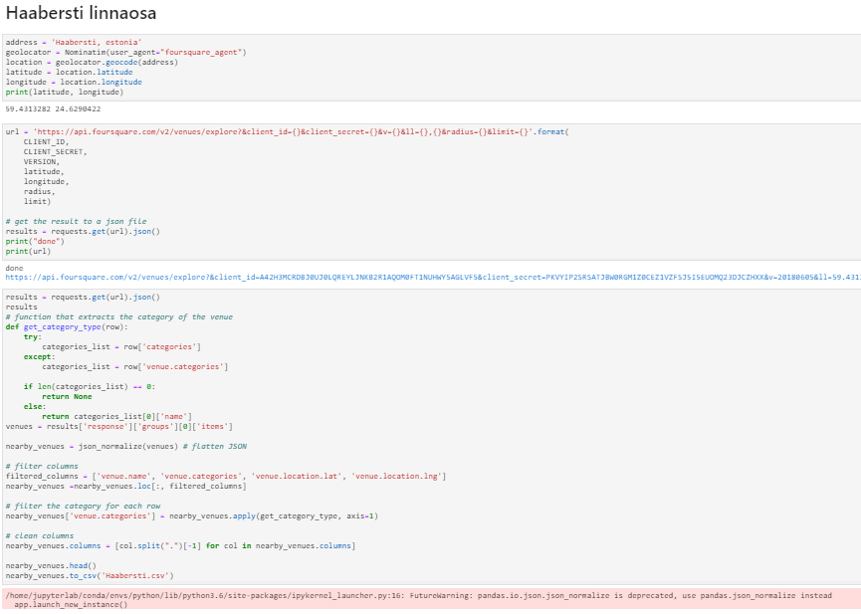
Then I had a AHAA moment
What if I change the code and make 7 unique request not combined request as the Lecture lab did it??
This means make unique Borough request on every area of city

Slide 12
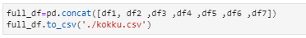
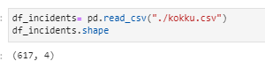
I did this in every Borough and made a combined/ full database
The result of this is much better:

Slide 13
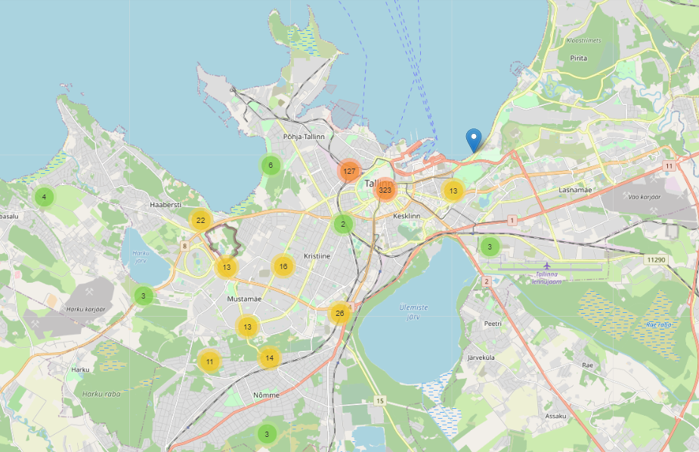
To put this in map- it looks like this:
Data is still crooked on the side of central city with 127+323 (more then half) of datapoints in there
Data in the area of City where most people live in is 13+3 = not valid for sure
As the difference in data amount in areas is so huge then the comparison is like comparing apples with planes

Slide 14
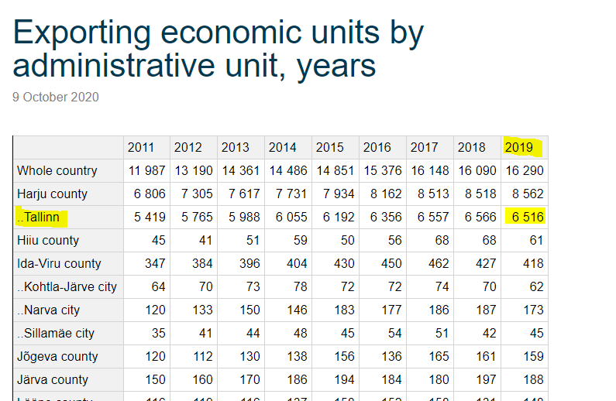
So its still not good………
Because the real business count (let alone the buss stations and parks etc what foursquare reads as venues is 10 time bigger)………
https://vana.stat.ee/413461

Slide 15
As a result:
Nice ap and API and really learned a lot, but its not valid in every location and a alternative is needed………..

